Slide 1
Bankruptcy Machine Learning Model
Kavish, Chang and Damian

Slide 2
Introduction
The aim of this project is to use machine learning to predict whether an individual will become bankrupt based on their financial history.
Uses of the model: can be used as a tool for credit loan assessments, providing efficient and accurate way to evaluate the risk of an individual becoming bankrupt
Data Processing
Splitting Data
Testing Model
Building ML Model
Training model
Making Predictions
User Interface

Slide 3
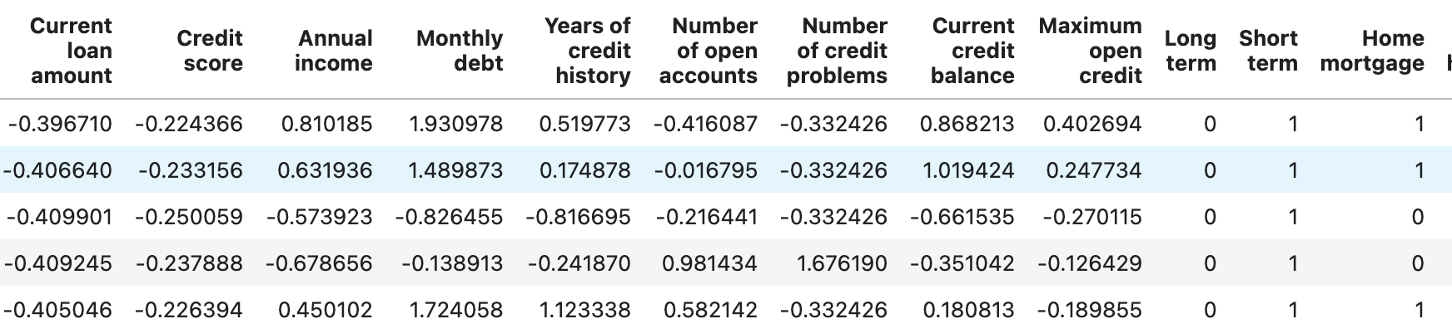
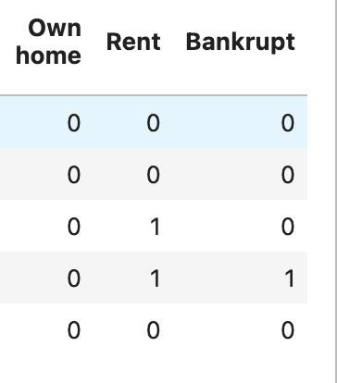
Background
Dataset: https://www.kaggle.com/datasets/zaurbegiev/my-dataset
Over 65, 000 lines of data
Variables in the dataset: Loan ID, Customer ID, Current loan amount, Term, Credit Score, Annual income, Current years in job, Home Ownership, Purpose, Monthly dept

Slide 4
Machine Learning Models
Neural Networks
Random Forest
Ensemble

Slide 5
Random Forest – Final Model
Random Forest is an ensemble learning method commonly used for classification, regression, and other machine learning tasks. It belongs to the family of tree-based models and is known for its high accuracy, robustness, and versatility.
Optimization: The model was optimized by altering the number of trees, tree depth and feature importance.

Slide 6
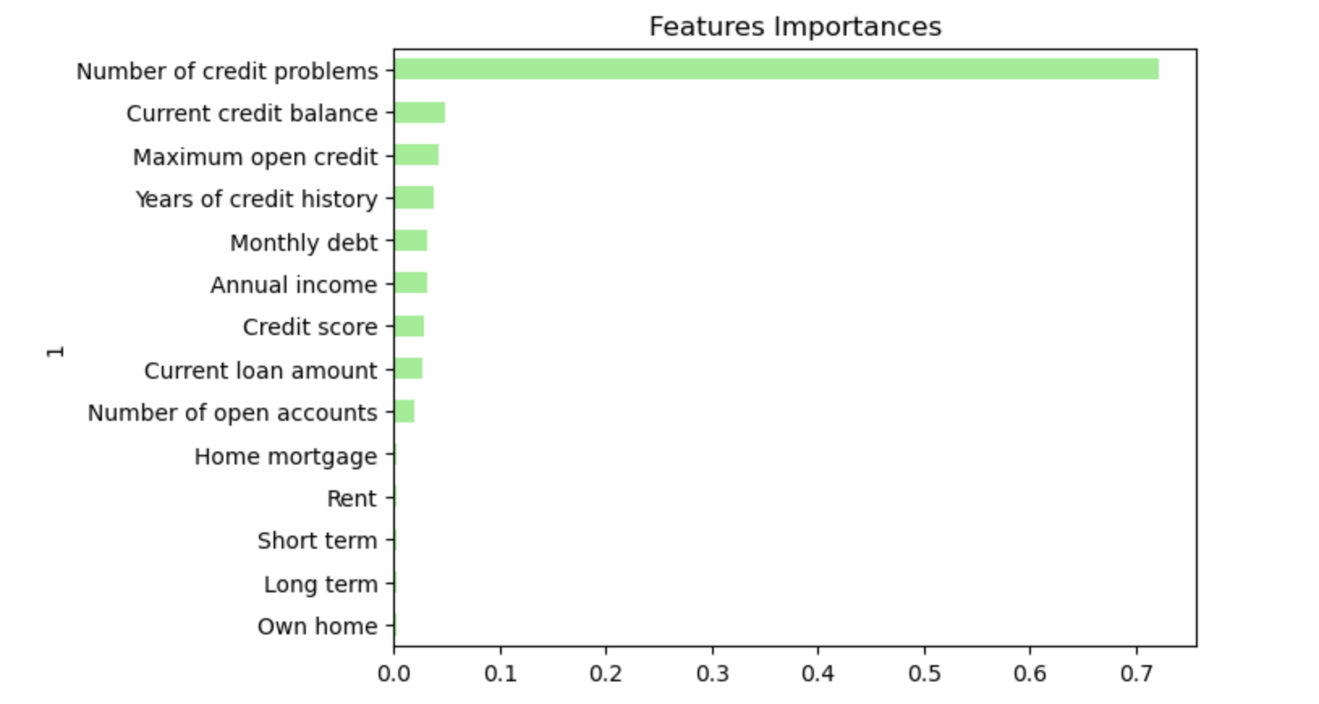
Random Forest

Slide 7
Ensemble

Slide 8
Neural Networks

Slide 9
User interface
Javascript

Slide 10
Demonstration

Slide 11
Limitations

Slide 12
Conclusion

